Slide 1

Predicting an Option contracts price
Capstone Project
Data Analytics Boot Camp
The University of Miami
E. Deutsch | D. Perez

Slide 2
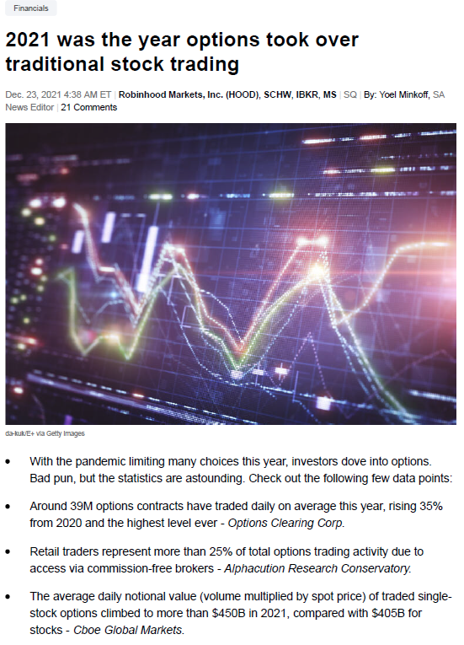
Why this topic?
We have a background in the field of finance
There are an abundance of opportunities in the derivatives market
Data analysis is essential in today’s world, this sector has many opportunities for this
An excellent challenge to apply what we have learned

Slide 3
Overview
Description of source data
Questions we hope to answer with the data
Data exploration phase
Tools and technologies
Analysis phase
Results of analysis
Recommendation for future analysis
Lessons learned
Conclusion

Slide 4
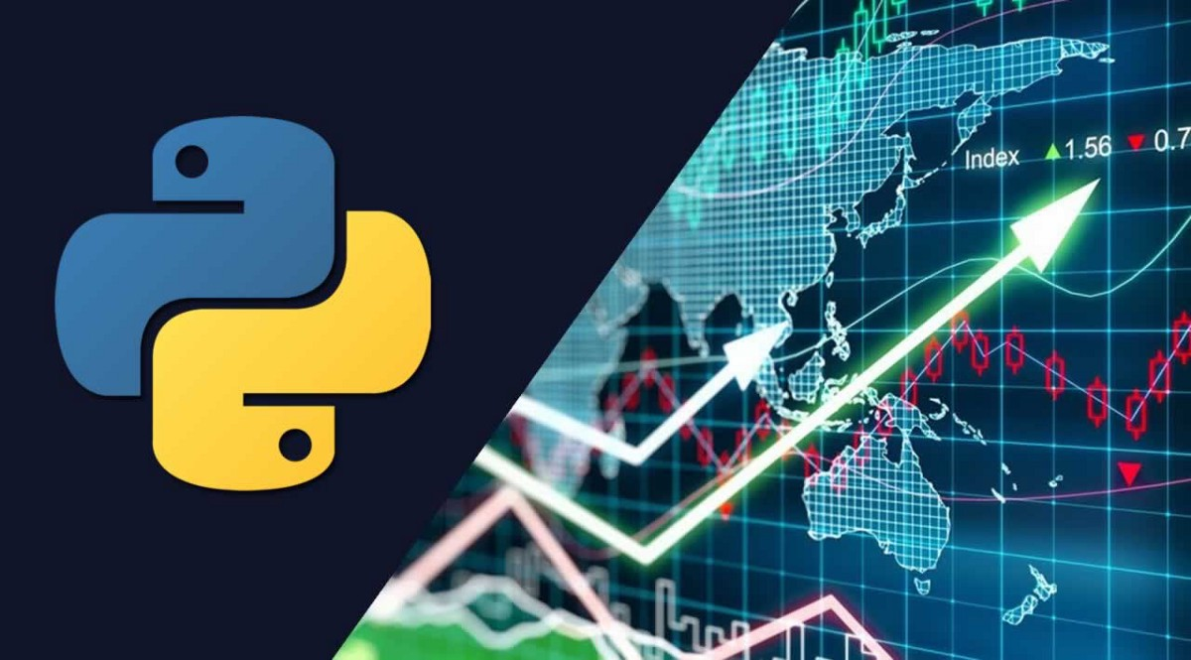
Questions to answer
Are there any correlation between the Contract Price and the features?
What feature(s) has the most significant effect on the predicted Contract Price?
What feature(s) has the least significant effect on the Contract Price?
What could we have done differently to get better results?
What is the Predicted Price for each contract?
What do we recommend for future analysis?
Notes:
Review the questions and see which should be changed… or as we complete the project we come back and update the questions we actually answered throughout the project

Slide 5
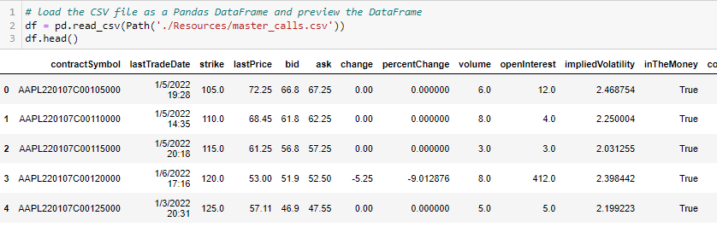
Data Source Description
Obtained through yfinance library
Objective is to predict the contract price within the stocks of the DOW30.
Notes:
Possibly add Test/Train

Slide 6
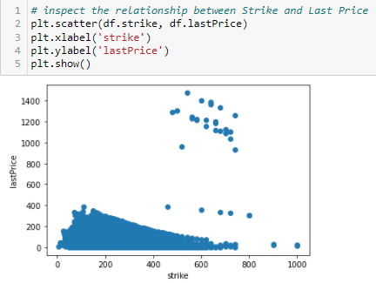
Exploration Phase
Researched possible machine learning models
Focused on multiple linear regression and random forest
Agreed on general project scope
Desired outcomes
Tools
Technologies

Slide 7
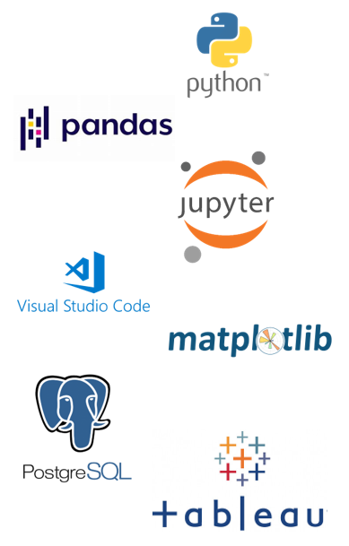
Tools and Technologies
Python
Pandas
Jupyter Notebooks
VS Code
Matplotlib
PostgreSQL
Tableau
Notes:
Waiting to see if we need more Logo’s to be included if not this is done

Slide 8
Algorithm Used???
Notes:
THIS SLIDE NEEDS TO BE 100% Editted…
It shows the imports they used which will be replaced with ours
Title should also be different

Slide 9
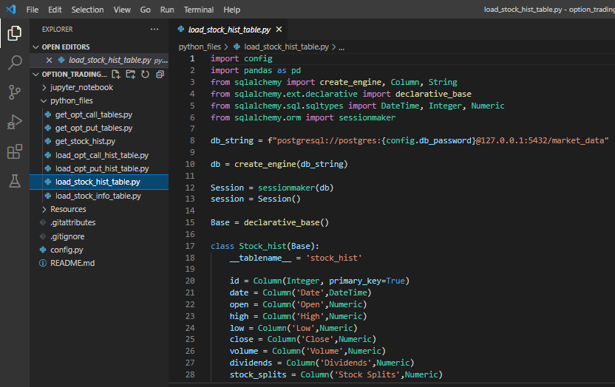
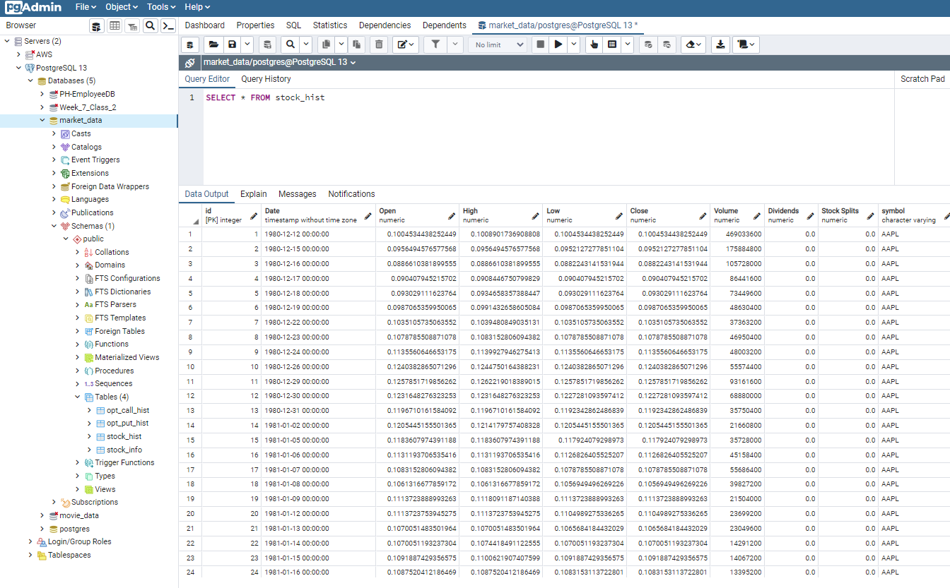
PostgreSQL Database
Sqlalchemy to postgresQL
PostgresQL DB and Tables
Notes:
Connecting Pandas to Postgres

Slide 10
Analysis Phase
Notes:
Segment 2 Submission Conducted Clean Up
Narrowed the Data Set
Uploaded Clean Data
Ran Correlation Analysis?

Slide 11
Analysis Phase
Notes:
After Scaling and normalization

Slide 12
Results
Notes:
Actual Price
Targeted MLR
MLR Complete

Slide 13
Results Demo

Slide 14
Recommendation for future analysis
Notes:
Review at end of project Obtain historical daily option chain history data to set up better sampling parameters
Look into factors affecting our model results with Random Forest
Perform further statistical analysis on more features……..
Increase knowledge of statistics principles

Slide 15
Lessons Learned
Notes:
Review at end of project Look well into the capability of tools before selection
Research more options and methodologies before setting on a machine learning model
Static Data …..

Slide 16
In Summary
Description of source data
Questions we hope to answer with the data
Data exploration phase
Tools and technologies
Analysis phase
Results of analysis
Recommendation for future analysis
Lessons learned
Conclusion
Notes:
Data analytics is an integral part of almost every industry today. These days It is hard to think of an industry in which Data Analytics does not play a major role. The options market
The use of options allows the investor to trade the market’s “third dimension”. Options allow the investor to trade not only stock movements but also the passage of time and movements in volatility. Most stocks don't have large moves most of the time. Only a few stocks actually move significantly, and they do it rarely. Your ability to take advantage of stagnation could turn out to be the factor deciding whether your financial goals are reached, or they remain simply a pipe dream. Only options offer the strategic alternatives necessary to profit in every type of market.

